Slide 1
Graphs
Alemitu Mequanint
AASTU

Slide 2
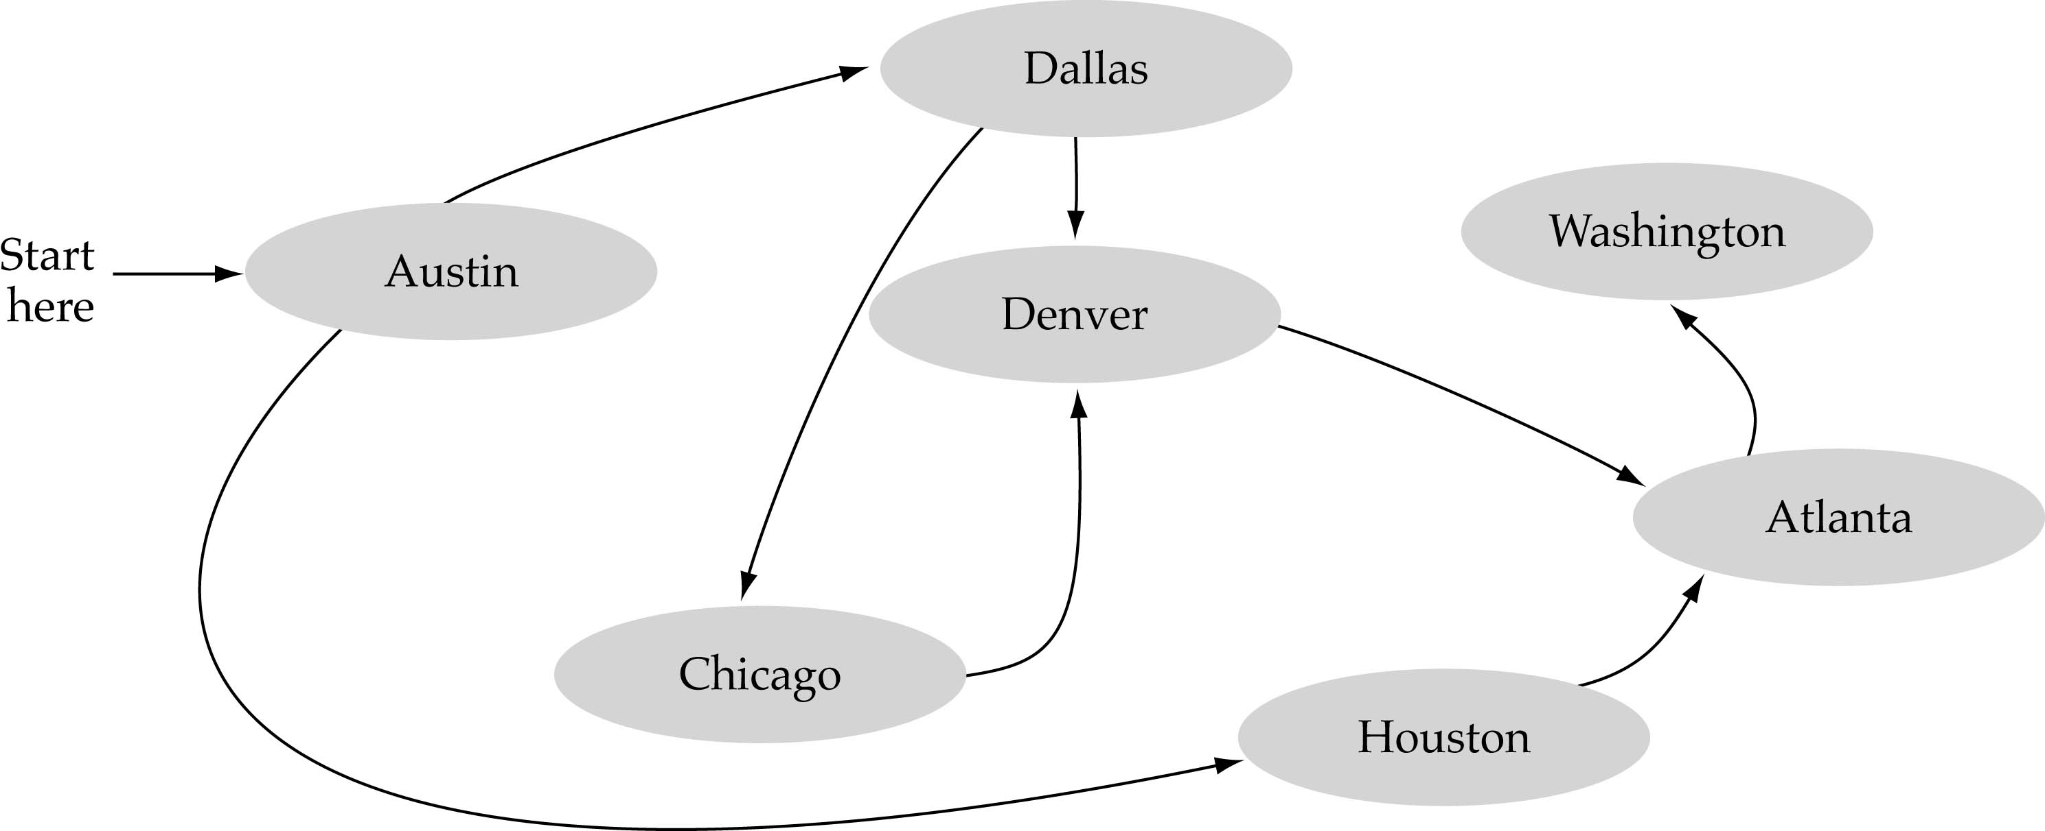
What is a graph?
A data structure that consists of a set of nodes (vertices) and a set of edges that relate the nodes to each other
The set of edges describes relationships among the vertices

Slide 3
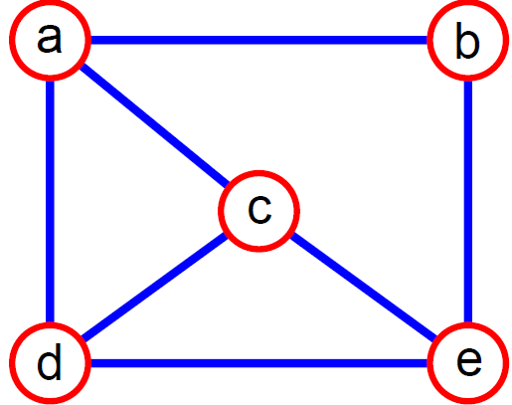

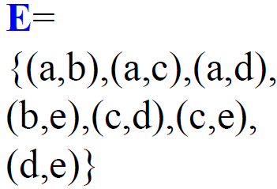
Formal definition of graphs
A graph G is defined as follows:
G=(V,E)
V(G): a finite, nonempty set of vertices
E(G): a set of edges (pairs of vertices)
An edge e = (u,v) is a pair of vertices
Example:

Slide 4
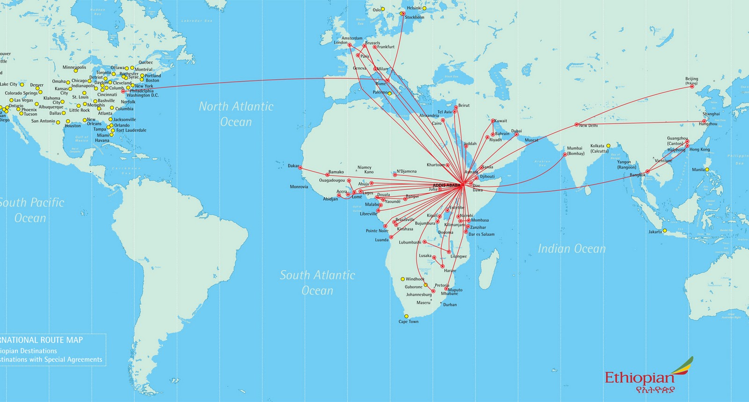
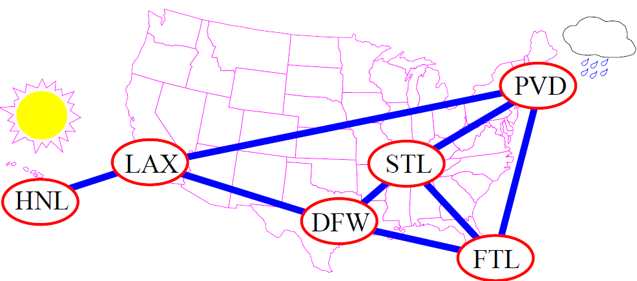
Applications
Airline Routes

Slide 5
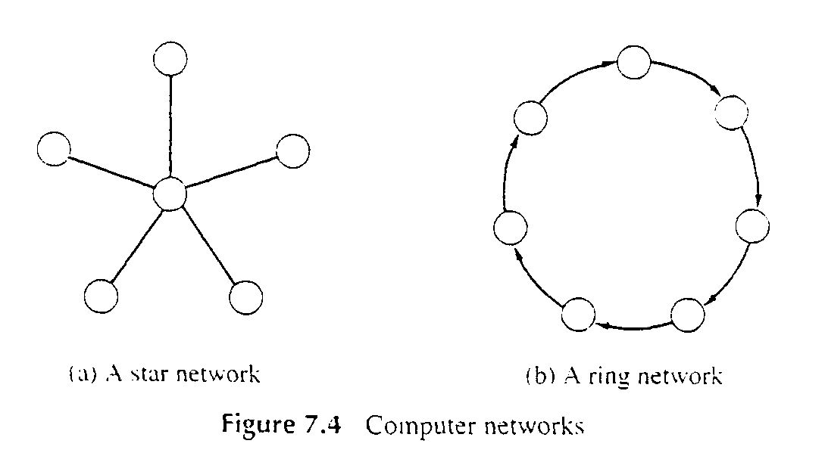
Applications
Computer Networks

Slide 6
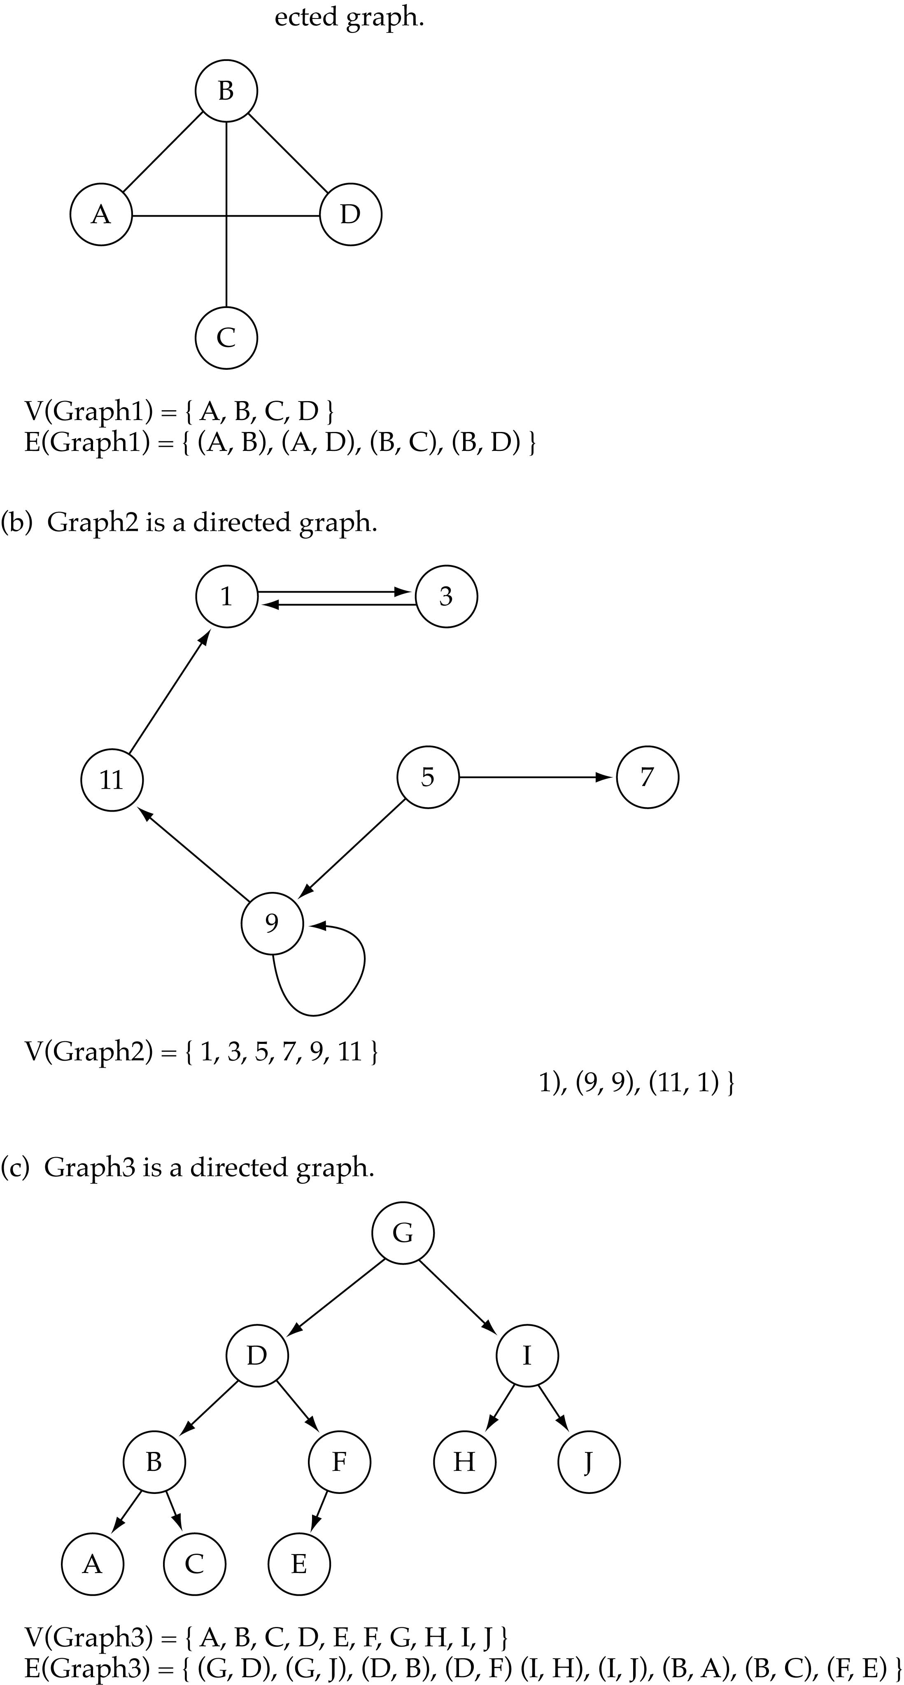
Directed vs. undirected graphs
When the edges in a graph have no direction, the graph is called undirected
(a) Graph1 is undirected graph

Slide 7
Directed vs. undirected graphs (cont.)
When the edges in a graph have a direction, the graph is called directed (or digraph)
Warning: if the graph is directed, the order of the vertices in each edge is important !!
  E is a set of ordered pairs of elements of V.
E(Graph2) = {(1,3) (3,1) (5,9) (9,11) (5,7)

Slide 8
Trees vs graphs
Trees are special cases of graphs!!

Slide 9
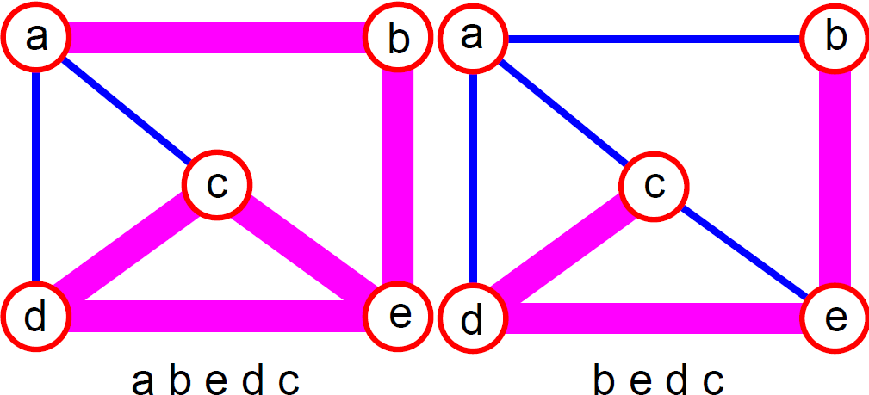
Graph terminology
Adjacent nodes: two nodes are adjacent if they are connected by an edge
Path: a sequence of vertices that connect two nodes in a graph
5 is adjacent to 7
7 is adjacent from 5

Slide 10
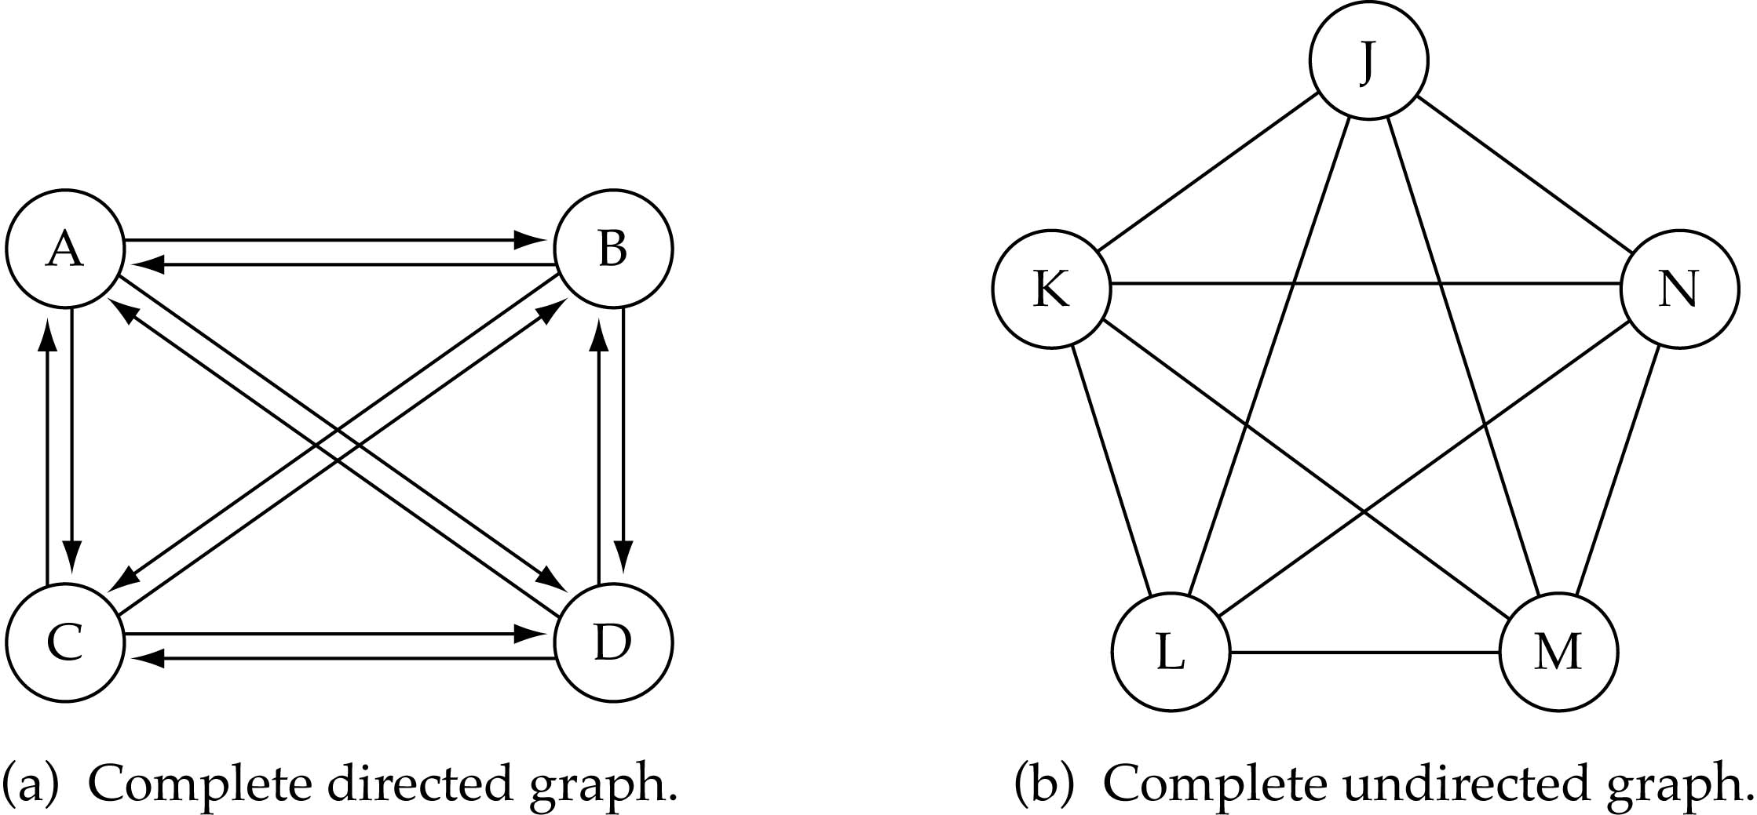
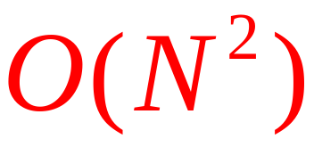
Graph terminology (cont.)
Complete graph: a graph in which every vertex is directly connected to every other vertex
What is the number of edges in a complete directed graph with N vertices?
N * (N-1)

Slide 11
Graph terminology (cont.)
What is the number of edges in a complete undirected graph with N vertices?
N * (N-1) / 2

Slide 12
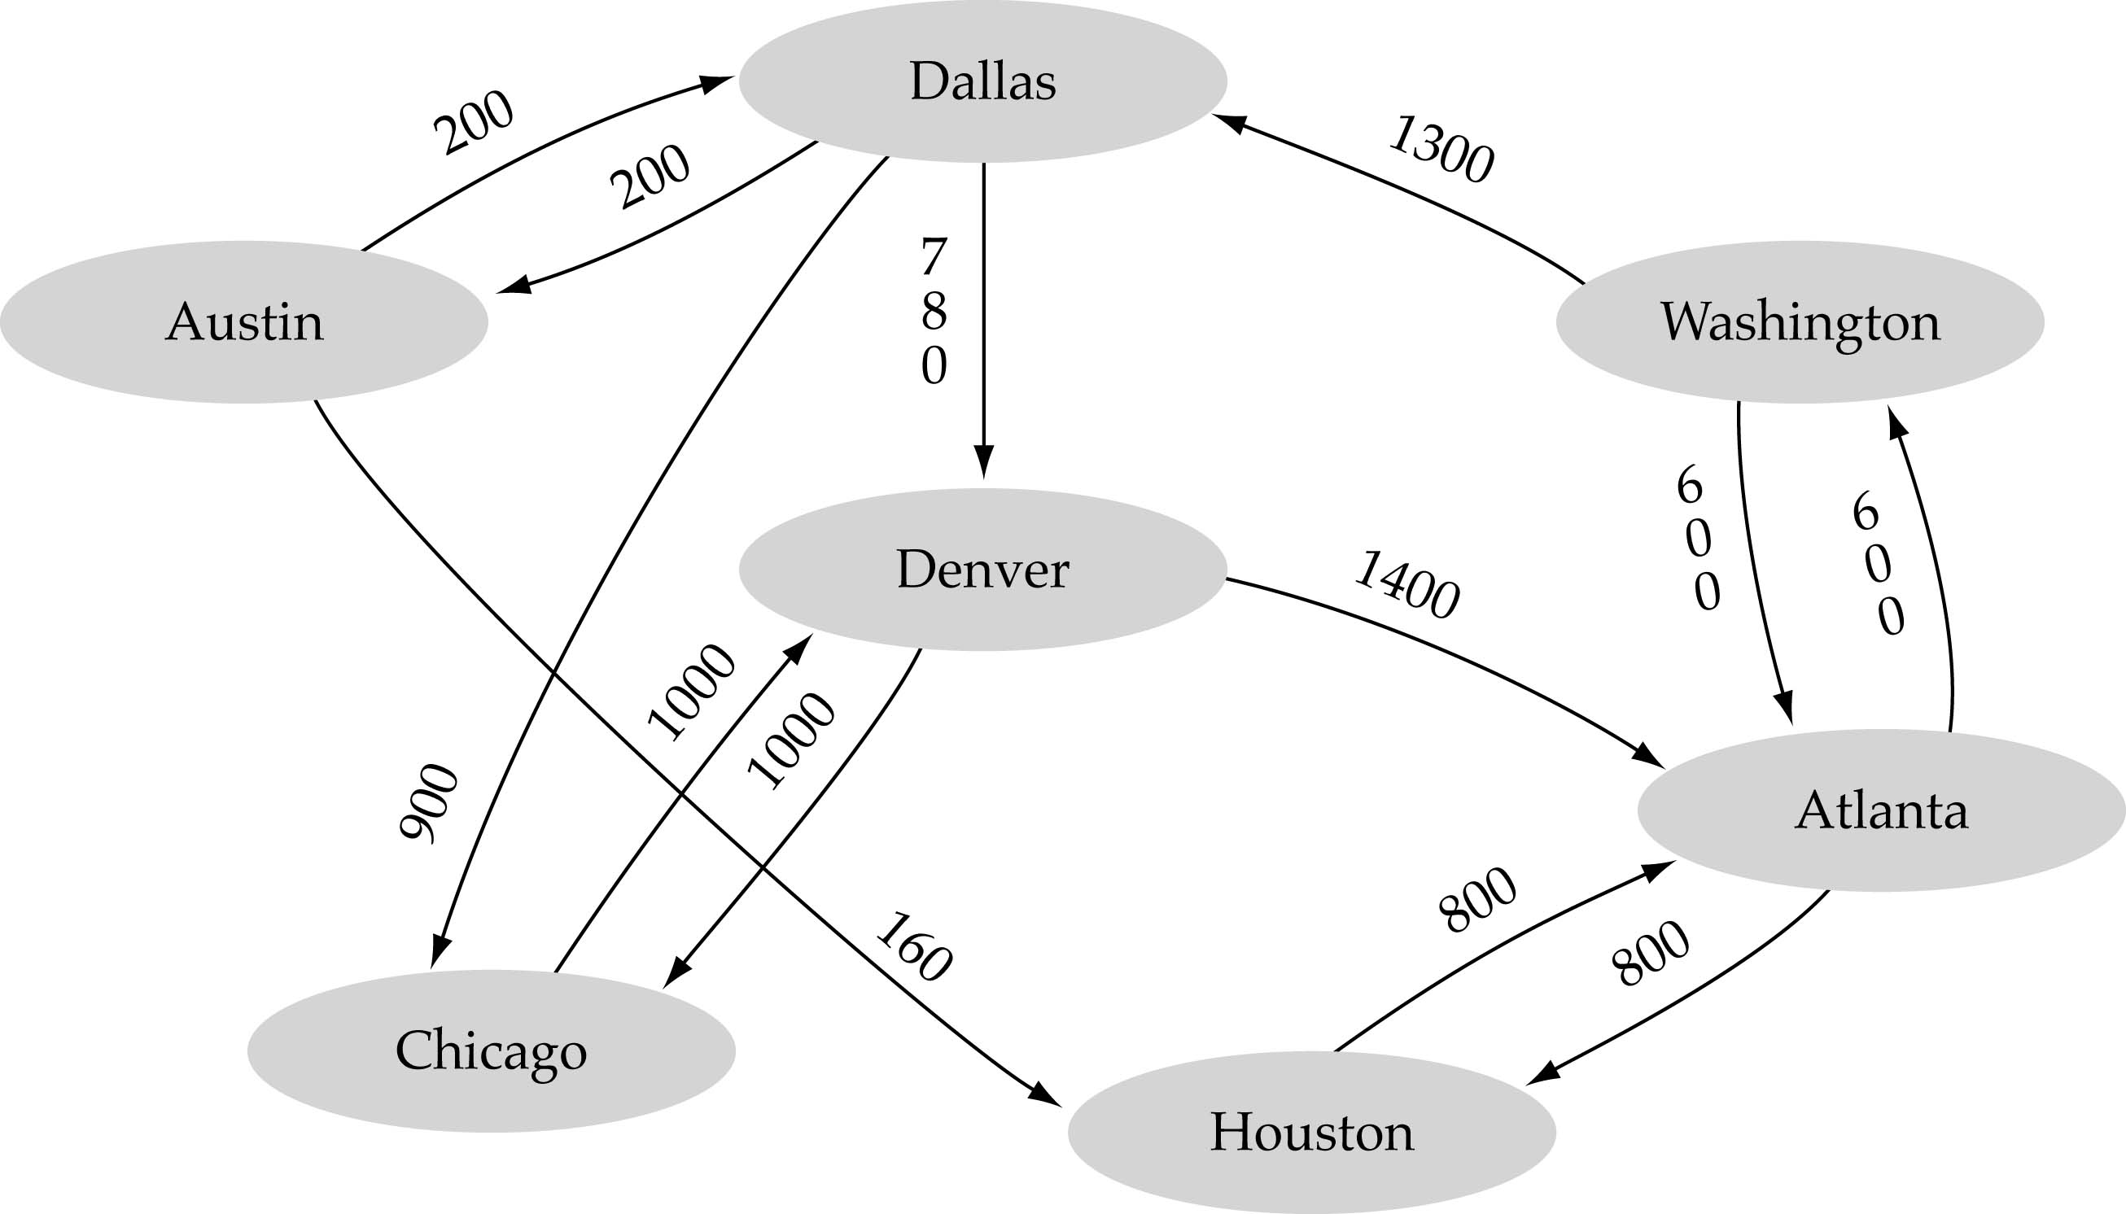
Graph terminology (cont.)
Weighted graph: a graph in which each edge carries a value
Airline route graph, in miles

Slide 13

Graph Implementation
Array-based implementation
  A 1D array is used to represent the vertices
  A 2D array (adjacency matrix) is used to represent the edges

Slide 14
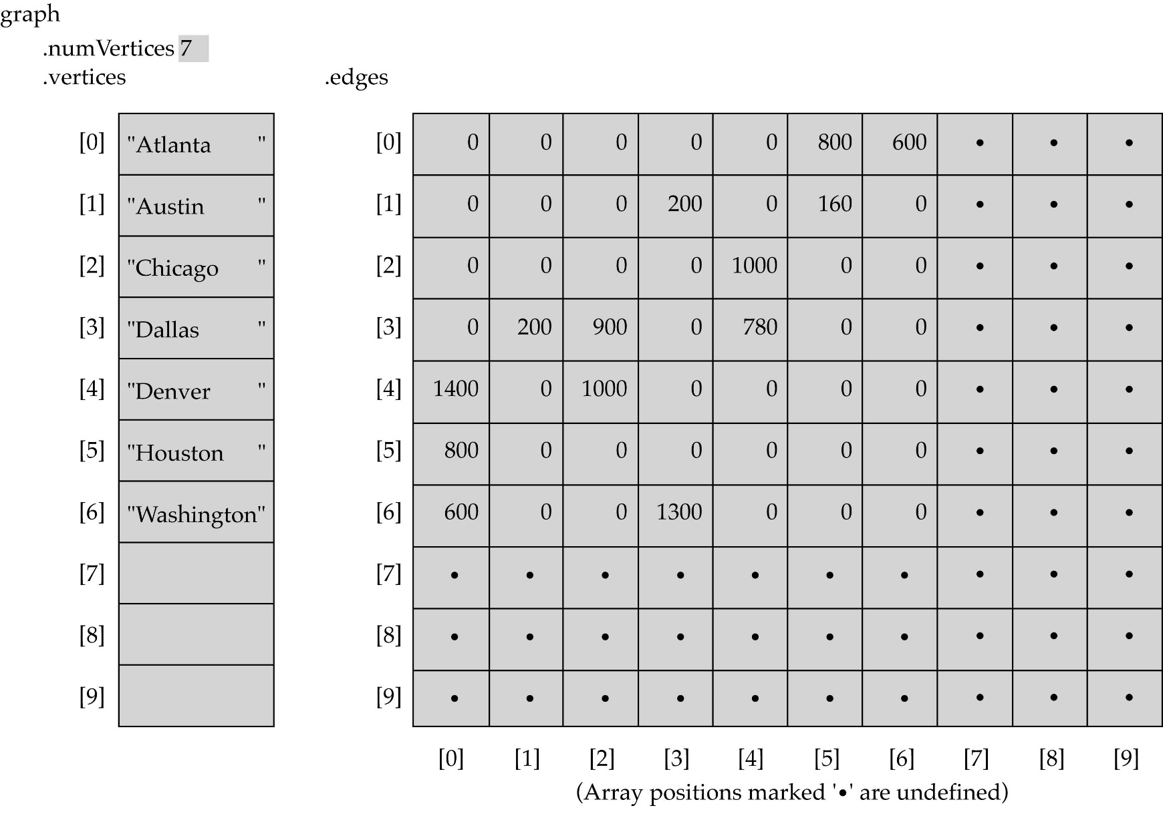
Array-based implementation

Slide 15
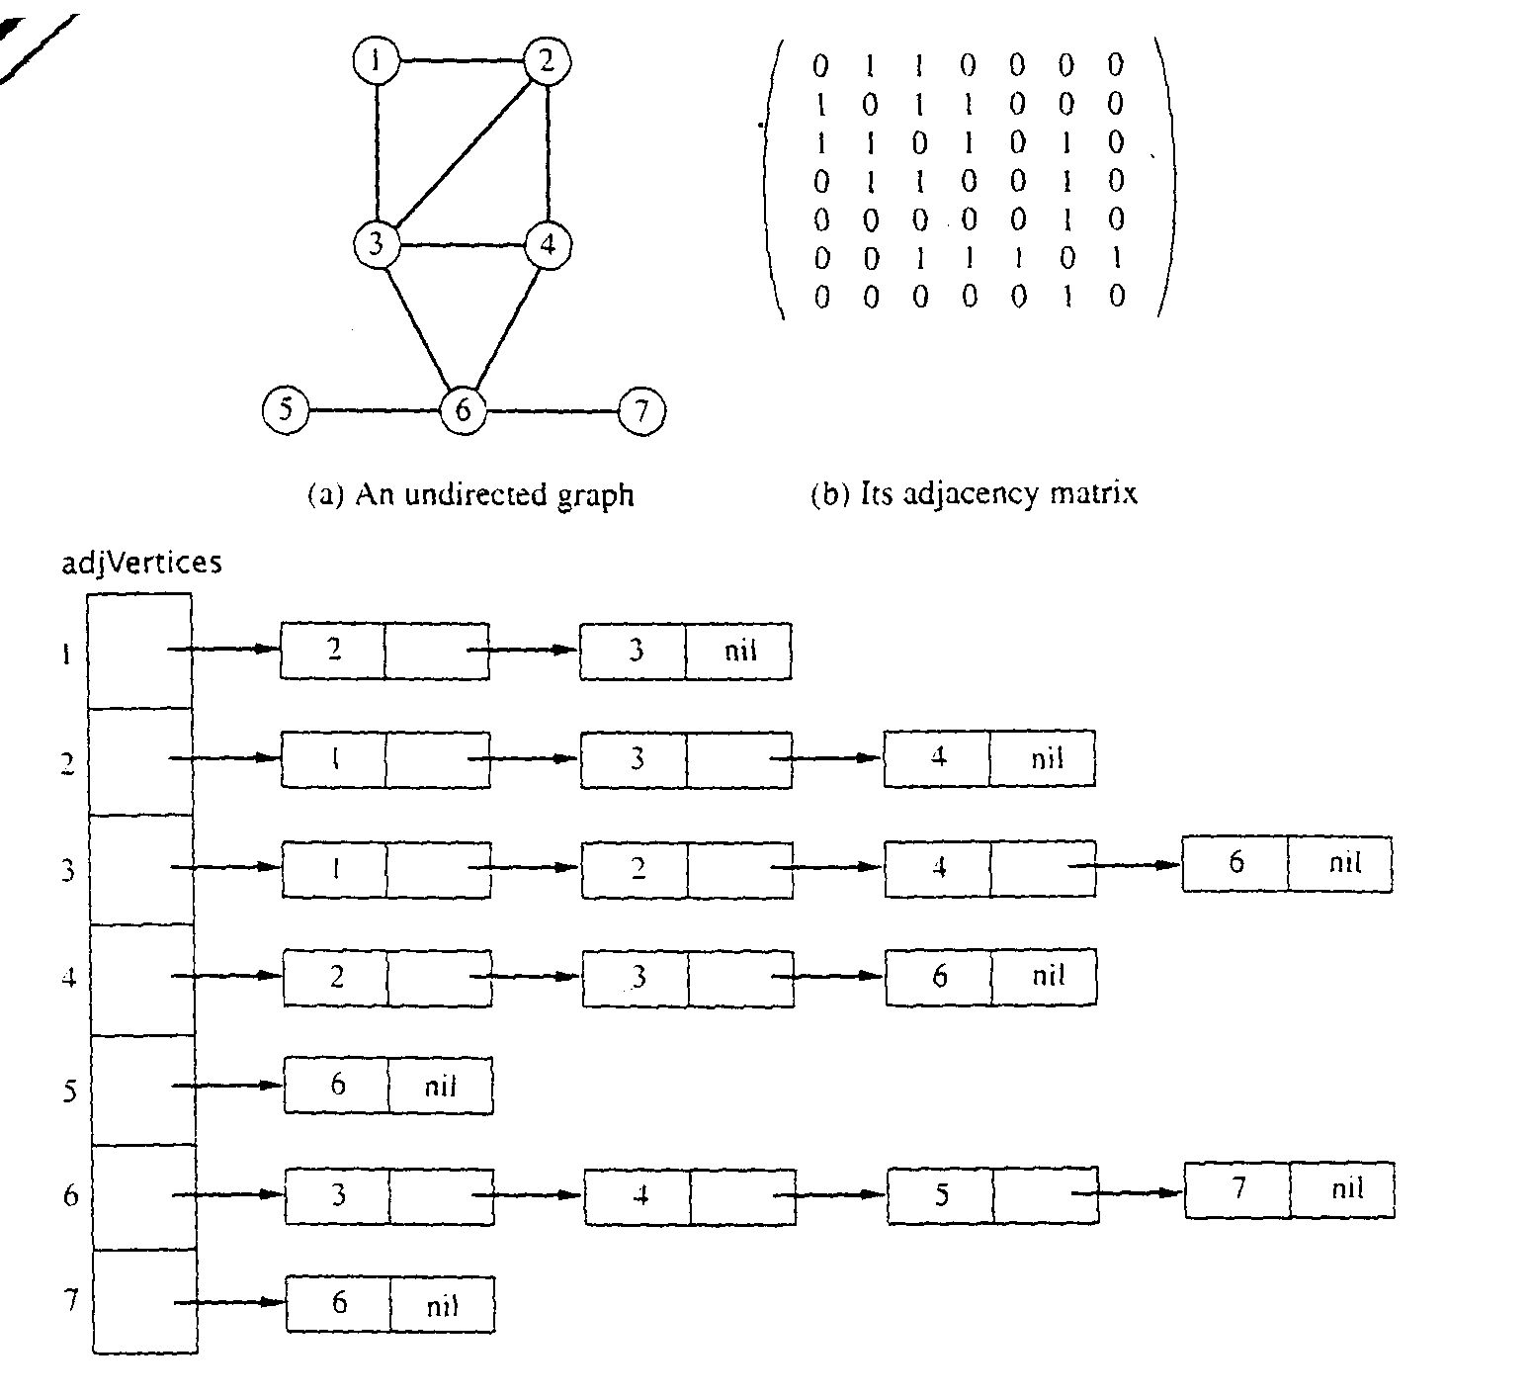
Adjacency Matrix Representation:
  Let G = (V,E), n = |V|, m = |E|, V = {v1, v2, …, vn)
  G can be represented by an n × n matrix
Implemented using 2D array

Slide 16
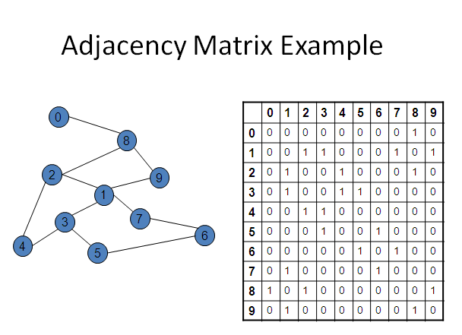

Slide 17
Graph implementation (cont.)
Linked-list implementation
  A 1D array is used to represent the vertices
  A list is used for each vertex v which contains the vertices which are adjacent from v (adjacency list)

Slide 18
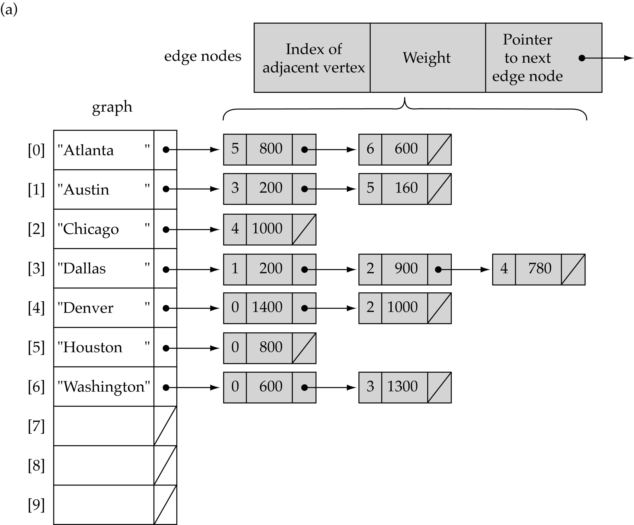
Linked-list implementation
Use a 1D array of linked lists

Slide 19
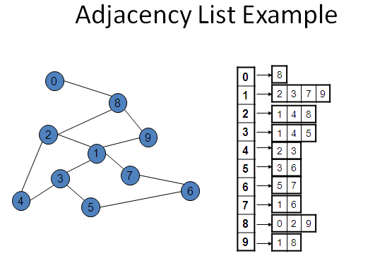
Each list A[i] stores the ids of the vertices adjacent to vertex i

Slide 20
Adjacency matrix vs. adjacency list representation
Adjacency matrix
  Good for dense graphs (more edges):|E|~O(|V|²)
  Memory requirements: O(|V| + |E| ) = O(|V|² )
  Connectivity between two vertices can be tested quickly
Adjacency list
  Good for sparse graphs(few edges) -- |E|~O(|V|)
  Memory requirements: O(|V| + |E|)=O(|V|)
  Vertices adjacent to another vertex can be found quickly

Slide 21
Graph Searching
Problem: find a path between two nodes of the graph (e.g., Austin and Washington)
Methods:
  Depth-First-Search (DFS) or
  Breadth-First-Search (BFS)

Slide 22
Depth-First-Search (DFS)
What is the idea behind DFS?
  Travel as far as you can down a path
  search deeper in the graph, when ever possible
Given an input graph G = (V, E) and a source vertex S, from where the searching starts.
  First we visit the starting node.
  Then we travel through each node along a path, which begins at S.
  That is we visit a neighbor vertex of S and again a neighbor of a neighbor of S, and so on.
DFS can be implemented efficiently using a stack

Slide 23
Algorithm
Input the vertices and edges of the graph G = (V, E).
Input the source vertex and assign it to the variable S.
Push the source vertex to the stack.
Repeat the steps 5 and 6 until the stack is empty & destination is found
Pop the top element of the stack and display it.
Push the vertices which is neighbor to just popped element, if it is not in the stack displayed (ie; not visited).
Exit.

Slide 24
Algorithm
Set found to false
Push(startVertex)
DO
Pop(vertex)
IF vertex == endVertex
Set found to true
ELSE
Push all adjacent vertices onto stack
WHILE !IsEmpty() AND !found
IF(!found)
Write "Path does not exist"

Slide 25
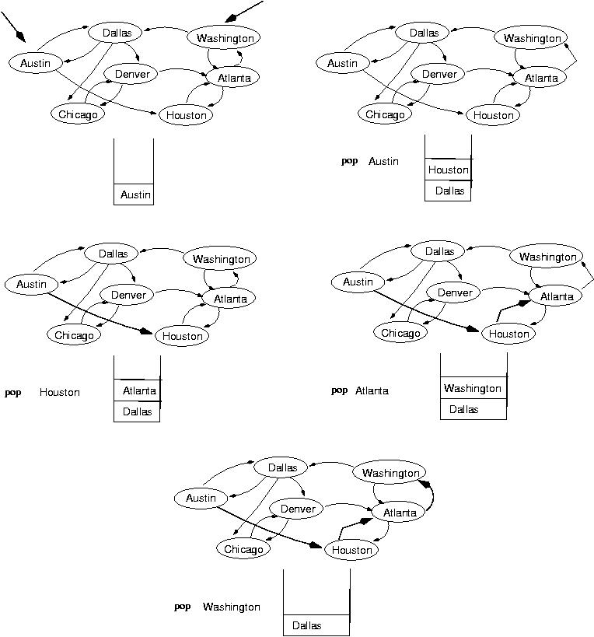
Example: Is there a path from Austin to Washington?
start
end
(initialization)

Slide 27
Found!

Slide 28
Breadth-First-Searching (BFS)
What is the idea behind BFS?
  Look at all possible paths at the same depth before you go at a deeper level
  Explore every vertex that is reachable from source vertex, S.
  Examine the entire vertices neighbor to S.
  Then traverse all the neighbors of the neighbors of S and so on.
  A queue is used to keep track of the progress of traversing the neighbor nodes

Slide 29
Breadth-First-Searching (BFS) (cont.)
BFS can be implemented efficiently using a queue
  Set found to false
  enqueue(startVertex)
  DO
  dequeue(vertex)
  IF vertex == endVertex
  Set found to true
  ELSE
  Enqueue all adjacent vertices onto queue
  WHILE !IsEmpty() AND !found
IF(!found)
Write "Path does not exist"

Slide 30
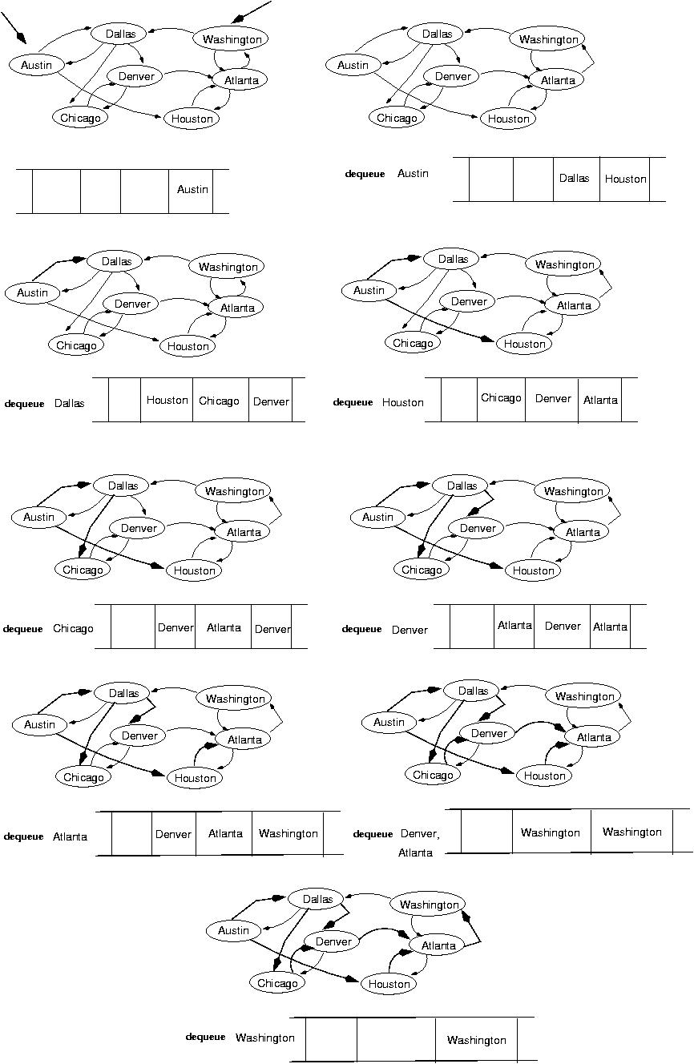
Example: Is there a path from Austin to Washington?
start
end
(initialization)

Slide 31
next:

Slide 32
Found!

